Slide 1
PFAS in Maine Shellfish
Presentation to the
Shellfish Advisory Council
September 19, 2023
Jim Stahlnecker
Surface Water Ambient Toxics (SWAT) Monitoring

Slide 2
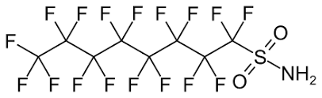
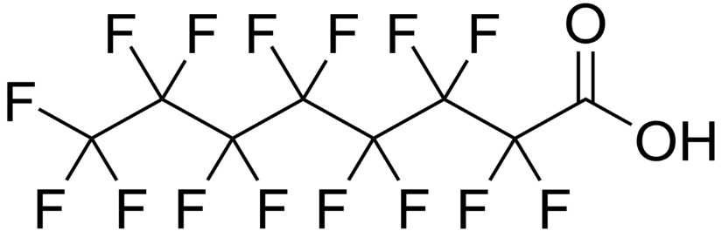
What Are PFAS? per- or polyfluoroalkyl substances
Perfluorooctanesulfonamide (PFOSA)
Perfluorooctane sulfonate (PFOS)

Slide 3
Marine Species Analyzed
Blue mussel
Soft shell clam
Eastern oyster
American lobster
Finfish species:
  pollock, striped bass, bluefish, Atlantic silverside, banded killifish

Slide 4
Changes Through Time
Increase from 12 to 40 PFAS compounds from lab
Decreasing detection levels/reporting limits
We see more compounds now, mainly due to better detection
Shifting focus from species to species as data is gathered and lessons are learned

Slide 5
History of Shellfish PFAS Testing
2013 - 12 compounds
  2 blue mussel (East End, Sears Is.) & 2 soft shell clam sites (Mast C., Presumpscot R.); only PFOSA & only at East End; all soft shell clam non-detects
2014 - 13 compounds
  2 blue mussel sites (Navy Pier, Harpswell C.); PFOSA in both (75% of reps) & PFHpA (25% of reps) at Navy Pier (perfluoroheptanoate)

Slide 6
History of Shellfish PFAS Testing
2015 - no PFAS shellfish testing
2016 - 13 compounds
  1 blue mussel site (Harpswell C.) at new location; only PFOSA (50% of reps)
2017 - 13 compounds
  2 soft shell clam sites (Harpswell C., Broad C. Eastport); all non-detects
2018 – no PFAS shellfish testing (lobster focus)

Slide 7
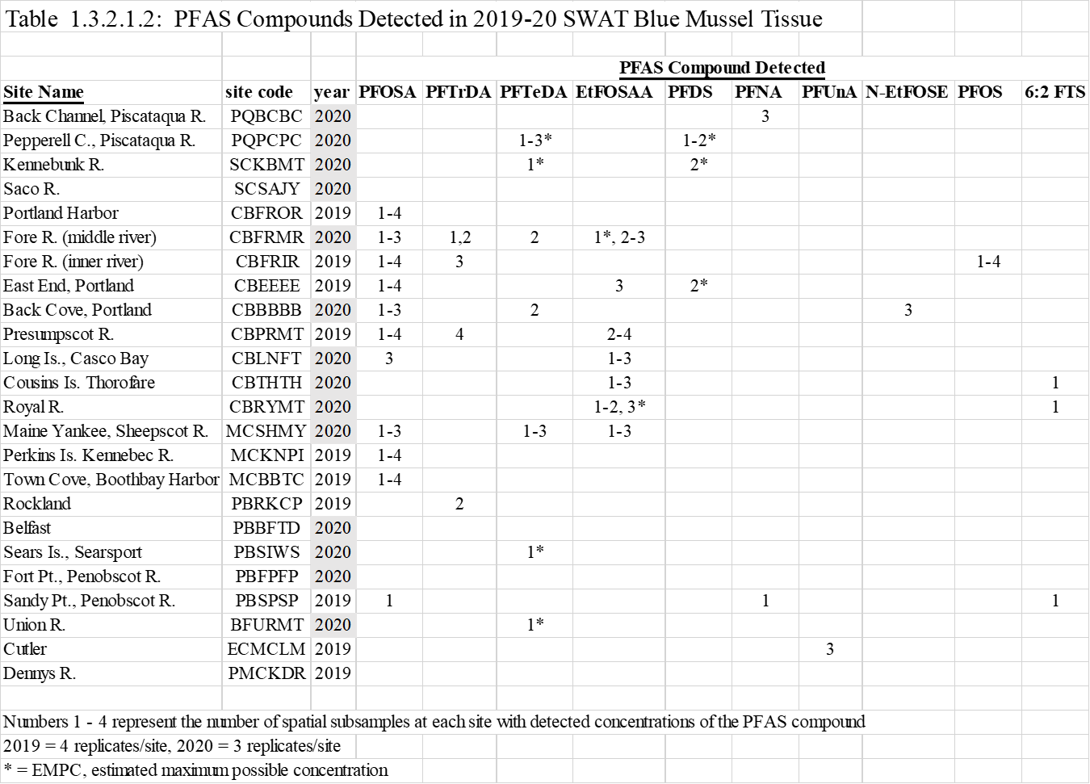
PFAS in Blue Mussel – 2019-20

Slide 8
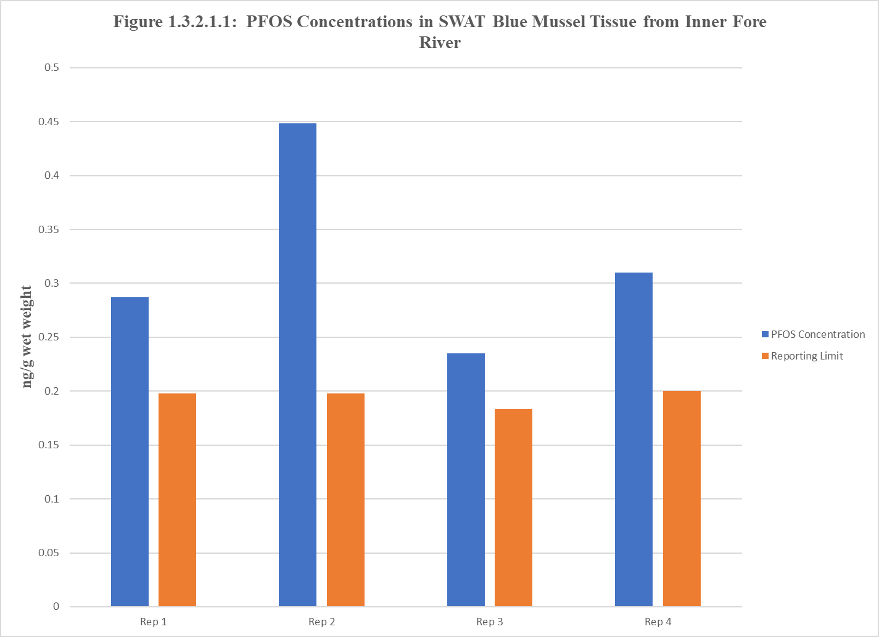
PFOS in Blue Mussel – Inner Fore R.

Slide 9
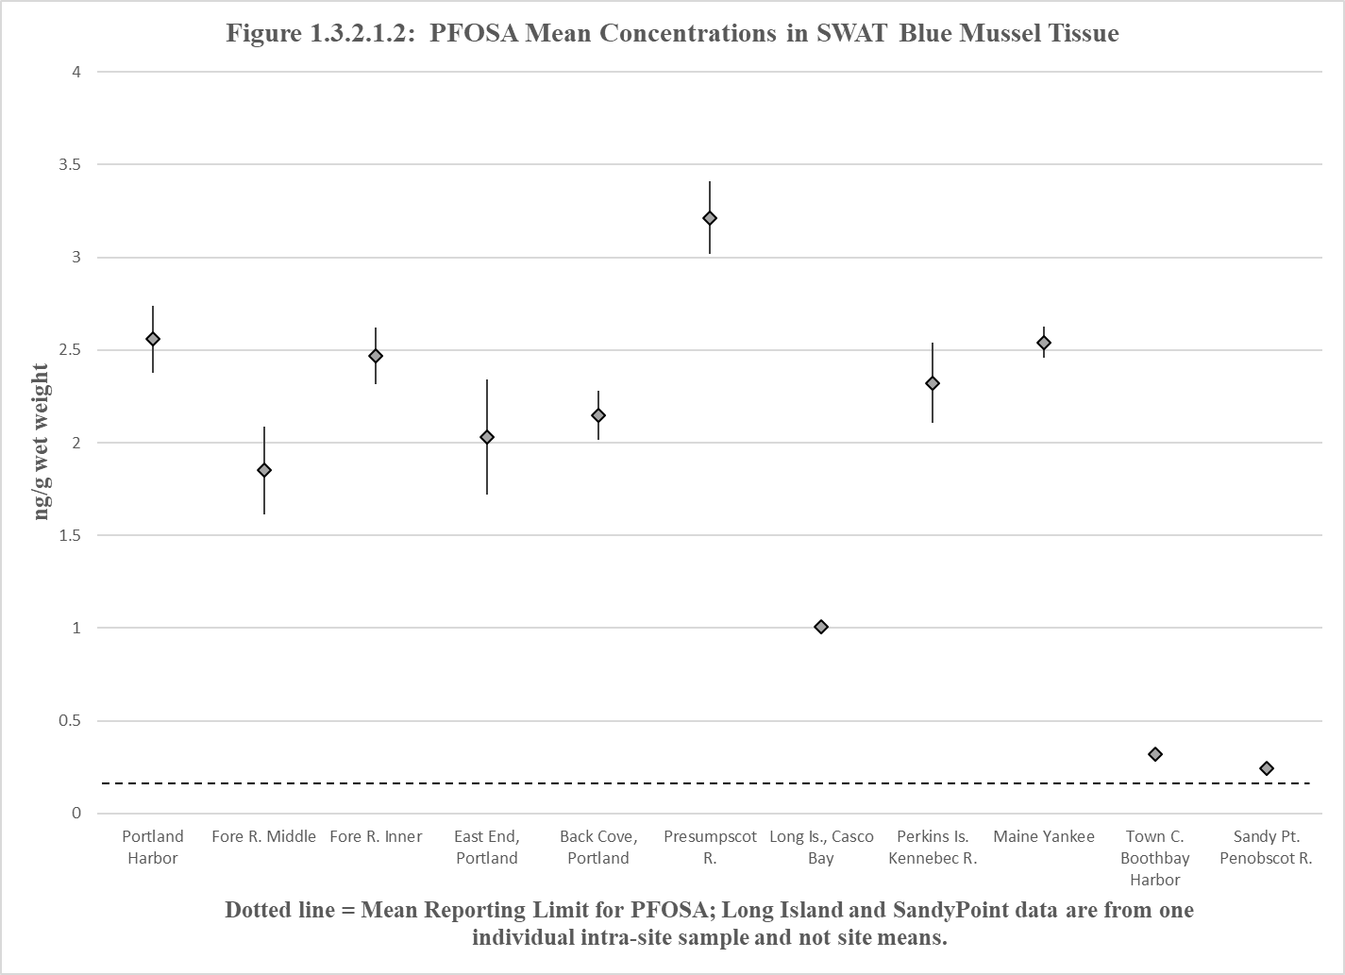
PFOSA in Blue Mussel – 2019-20

Slide 10
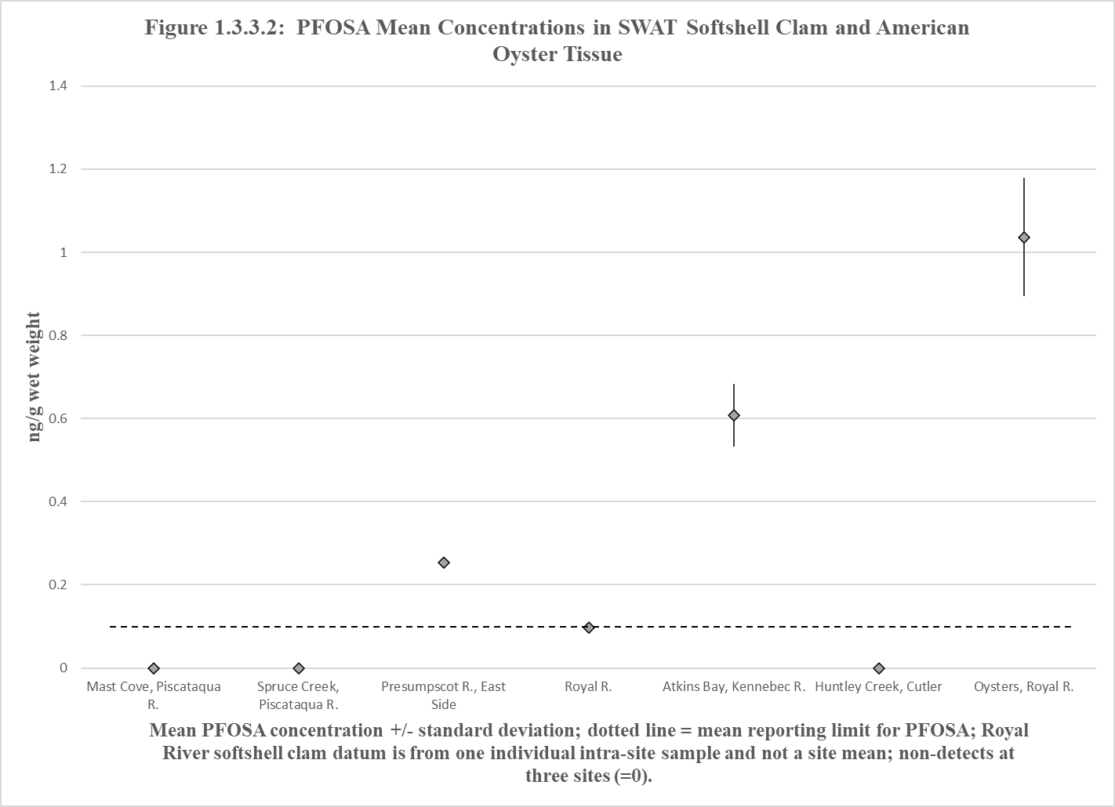
PFOSA in Soft Shell Clam, Oyster

Slide 11
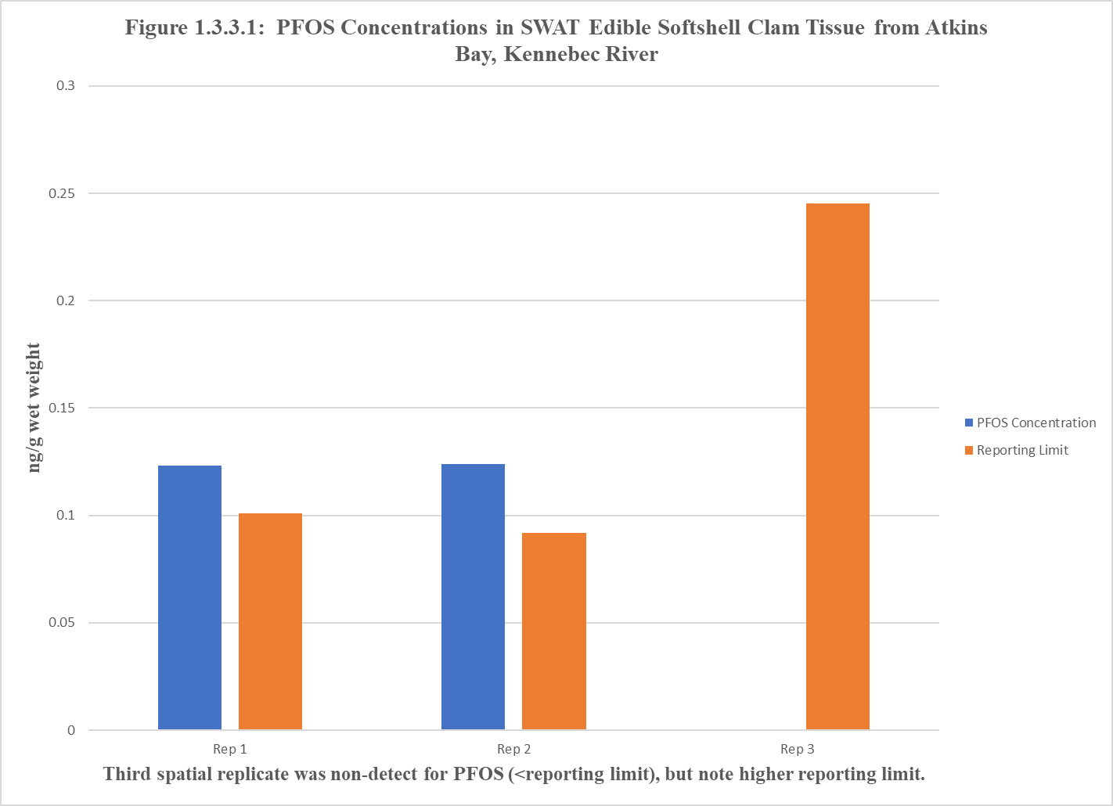
PFOS in Soft Shell Clam – Atkins Bay

Slide 12
PFAS in Soft Shell Clam & Oyster - 2022

Slide 13
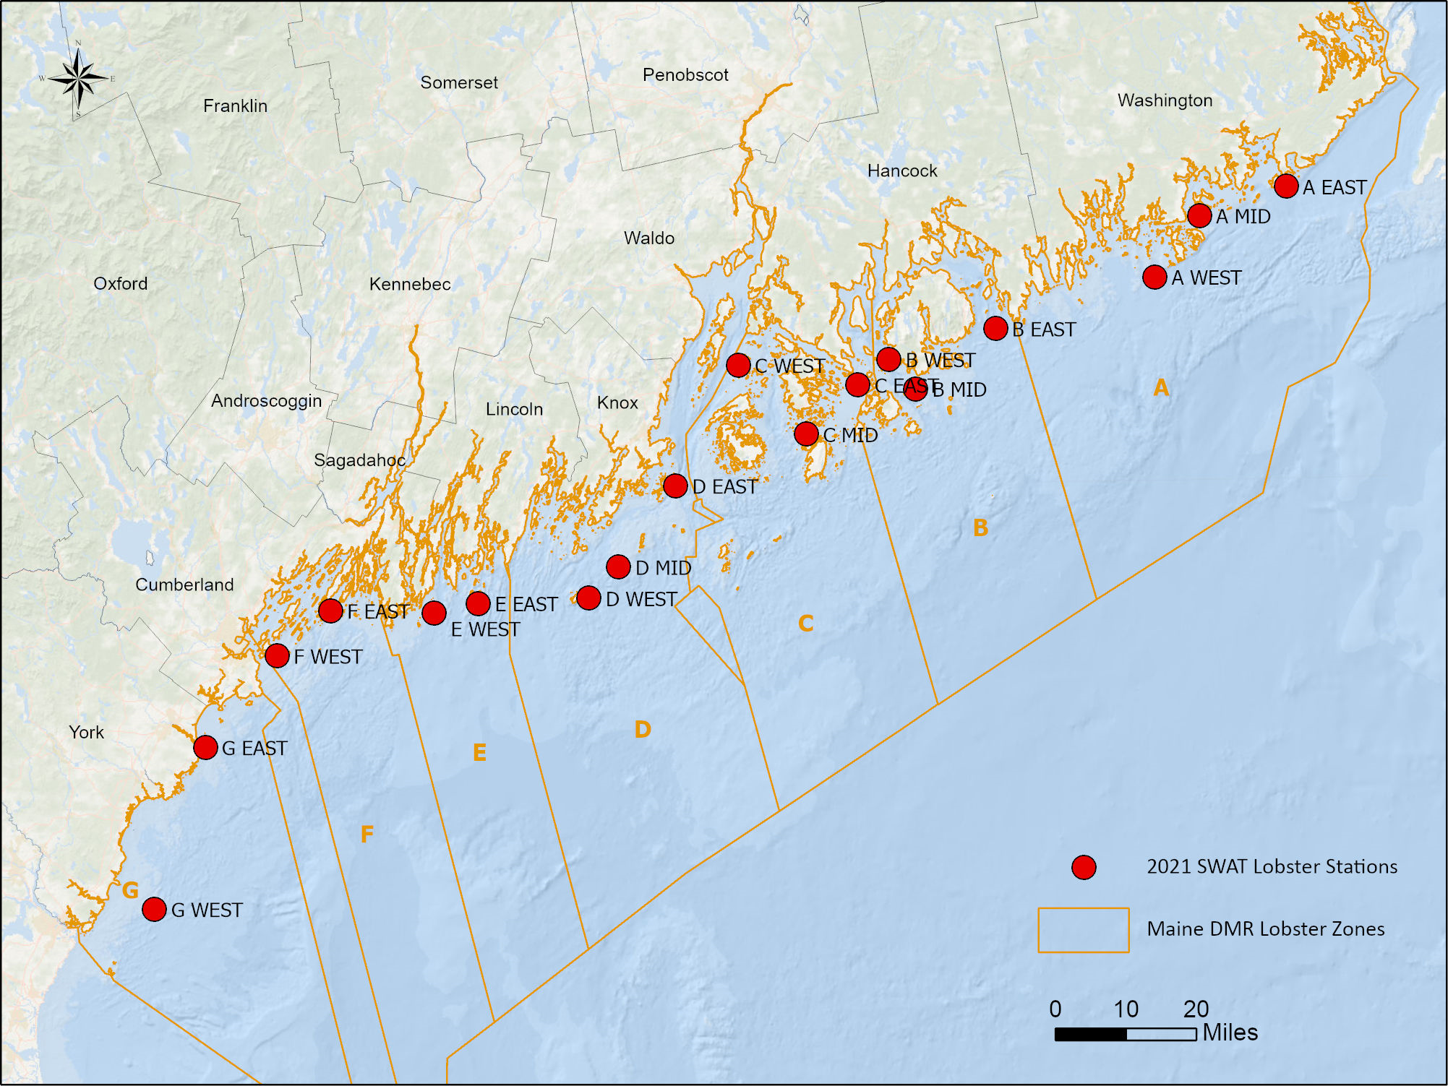
SWAT PFAS American
Lobster Stations - 2021
13

Slide 14
PFOS in Lobster Muscle - 2021

Slide 15
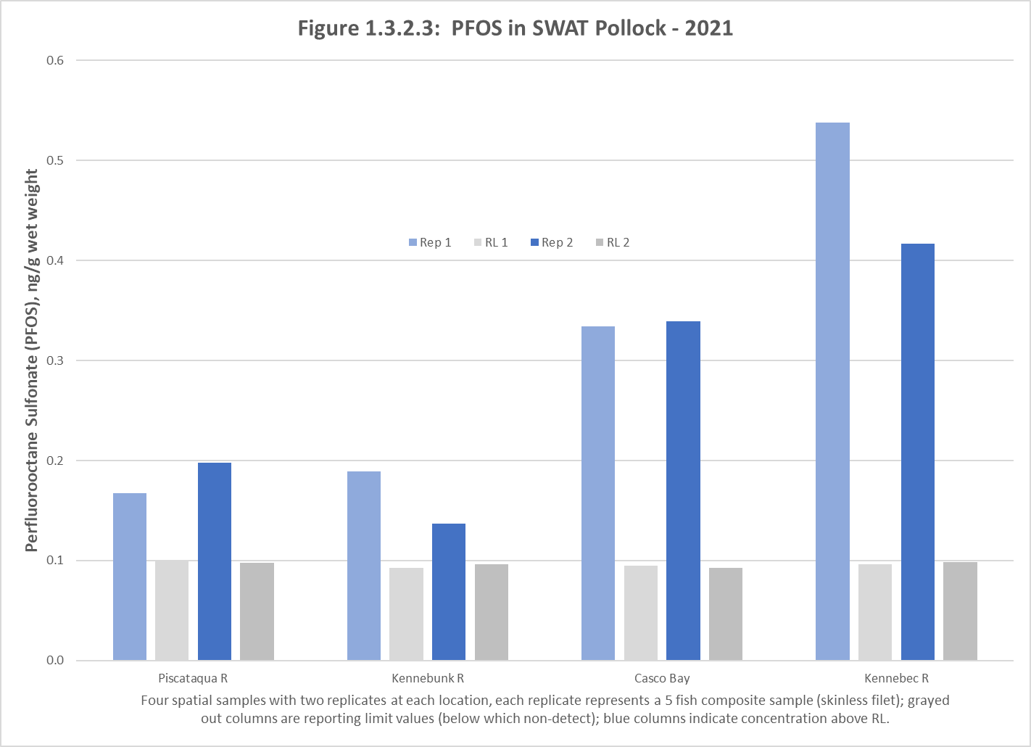
PFOS in Pollock - 2021

Slide 16
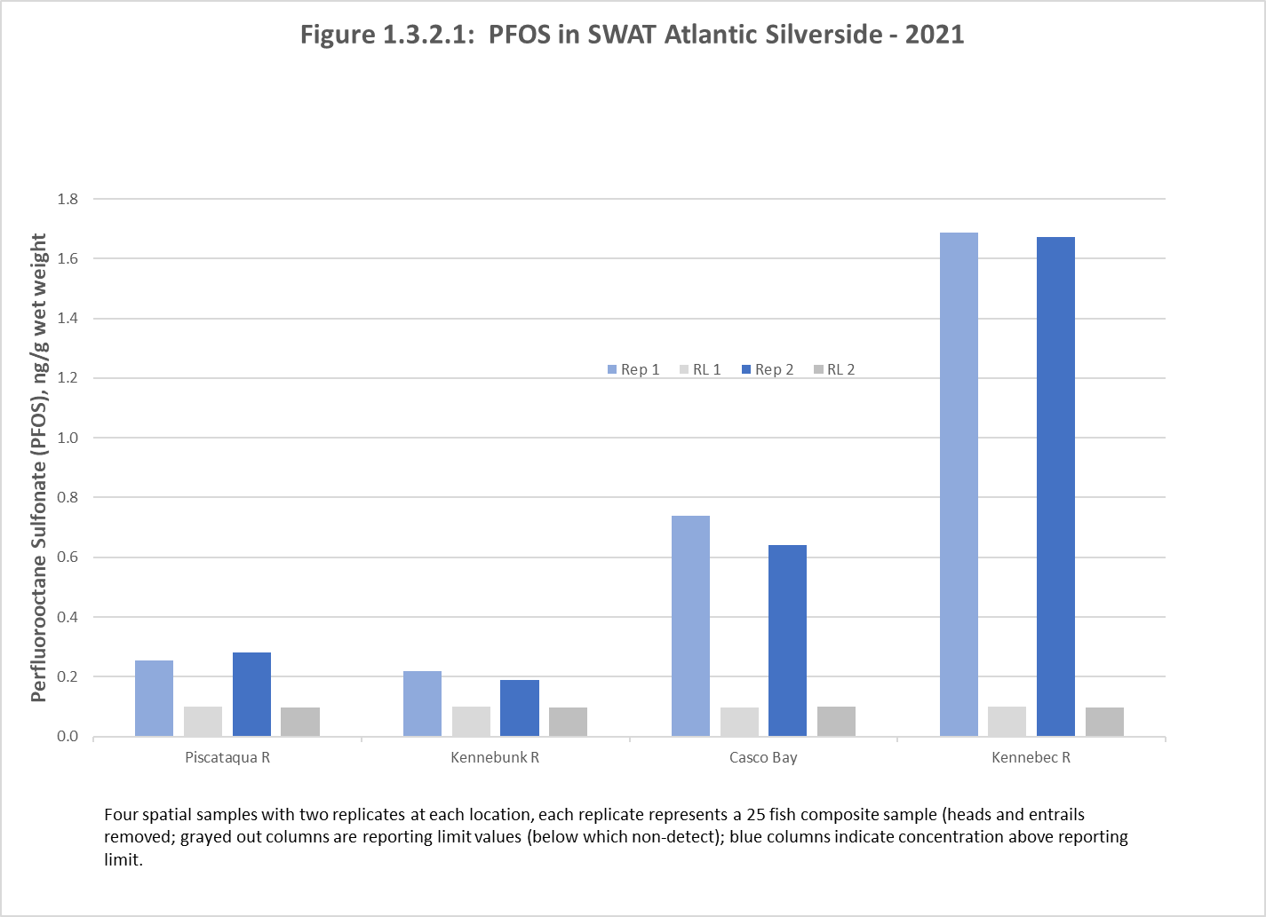
PFOS in Atlantic Silverside -
2021

Slide 17
PFAS in Bivalves
No PFOS detected in soft shell clam tissue except at Atkins Bay, Kennebec R.
No PFOS detected in Royal R./Casco Bay American oyster tissue
No PFOS detected in blue mussel tissue except at Inner Fore River
PFOSA in about half of blue mussel sites & half of soft shell clam sites

Slide 18

Jim Stahlnecker james.stahlnecker@maine.gov
(207) 215-6954

